Slide 1

R for Beginners
Tess Cherlin
tess.cherlin@jefferson.edu
@alldayscientess

Slide 2

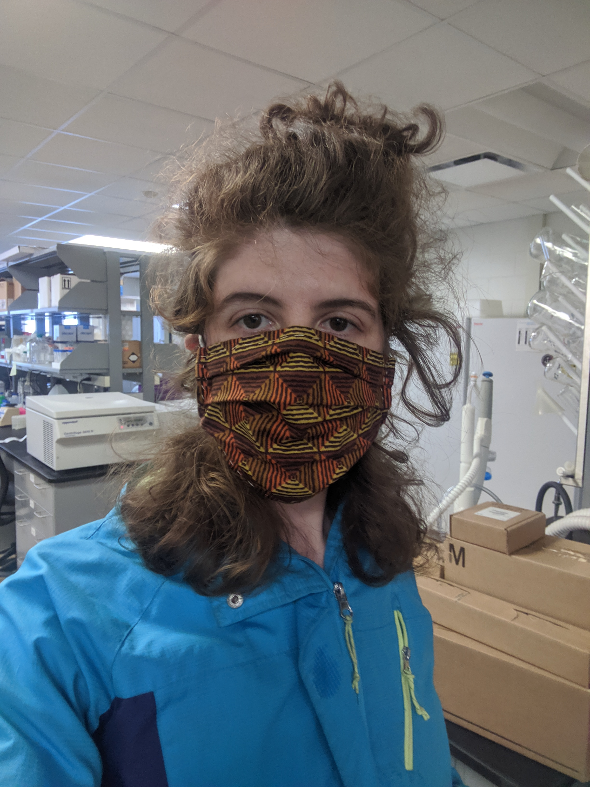
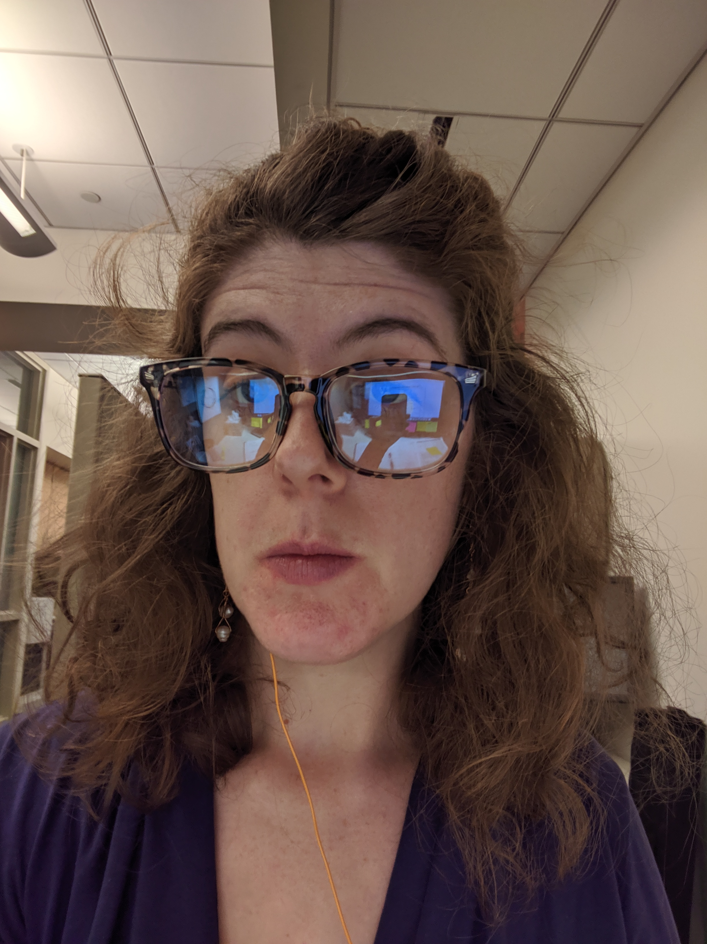

Introduction
Notes:
So, a little introduction about me, I’m a PhD student at Thomas Jefferson University in the Genetics, Genomics, and Cancer Biology where I use both wet lab research and computational research to study small molecules in our cells that contribute to cancer. And like our last speaker I had no coding background before I started in my lab in 2015. If I could learn this so can you!

Slide 3

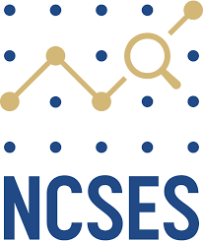
RLadies Global #BlackLivesMatter
While the R-Ladies mission is focused on improving gender diversity within the R community, we also recognize both the struggle that Black people face, and the compound effect of intersectionality when a member identifies with multiple underrepresented groups. R-Ladies Global makes a commitment to improve how the organization supports Black, Indigenous and People of Color
Women, Minorities, and Persons with Disabilities in Science and Engineering
2019 Report
https://ncses.nsf.gov/pubs/nsf19304/data
Notes:
I just want to take a moment to recognize those who have died at the hands of racism and police violence. The Rladies Global released a statement of solidarity with the #BlackLivesMatter Movement which Alice covered earlier in this talk. In an effort to increase my understanding of the representation in the STEM especially computer science field, today we are going to use datasets from the Women, Minorities, and Persons with Disabilities in Science and Engineering 2019 Report.

Slide 4
Women, Minorities, and Persons with Disabilities in Science and Engineering
2019 Report
A. Biological_or_Life_scientist
B. Computer_and_information_scientist
C. Mathematical_scientist
D. Physical_scientist
E. Psychologist
F. Social_scientist
G. Engineering_occupations
A. Hispanic_or_Latino
B. American_Indian_or_Alaska_Native
C. Asian
D. Black_or_African_American
E. Native_Hawaiian_or_Other_Pacific_Islander
F. White
G. More_than_one_race
B
C
F
G
A
D
E
D
C
F
A
B
E
G
Notes:
While you can use excel to plot the datasets we will be using today to show the gender and race/ethnicity in STEM Careers and Computer Science,

Slide 5
Objectives
Goal
To become familiar and comfortable with the basics in R in order to pursue future learning and develop a greater appreciation of disparities in STEM careers, especially Computer Science
Provide a brief introduction to R and RStudio
Become familiar with the RStudio environment
Learn how to open R code and read in data files in Rstudio
Learn how to manipulate and write data in RStudio
Calculate basic statistics in RStudio
Create and and save barplots in RStudio

Slide 6


R and RStudio
R is a language and environment for statistical computing and graphics.
RStudio is an integrated development environment for R
Notes:
I’m not an expert

Slide 7
R for Beginners
This is going to be hands-on and hopefully fun!
It’s not going to be perfect or exhaustive (I don’t know everything!!!)
There are many ways to do everything – when in doubt GOOGLE “how do I ______ in R?”
Notes:
I’m not an expert

Slide 8
Step 1
Download the files from Github → move folder to Desktop https://github.com/alldayscientess/RLadies
Open RStudio
Set working directory
Open R code
Notes:
I’m not an expert

Slide 9
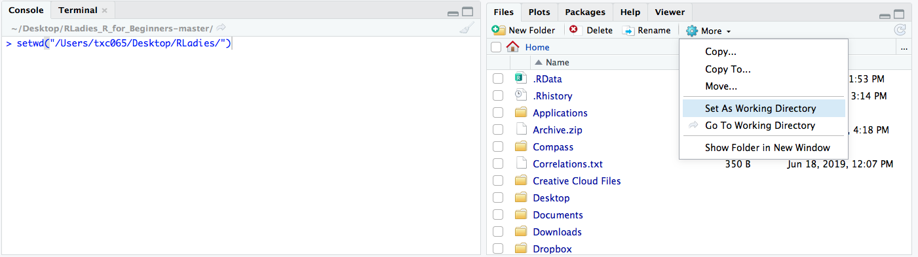
MAC: setwd(“/Users/tess/Desktop/Rladies”)
PC: setwd(“C:/Users/tess/Desktop/Rladies”)

Slide 10
Step 2 RLadies_R_for_Beginners_Intro.R
Learn basic commands in R
Learn to assign values to variables
Discover types of data
Notes:
I’m not an expert

Slide 11
Different variables contain different types of data
Variable | Data Type
Integer (Int) / Numeric | 1, 2, 3, 4, 5
Character (char) | A, a, B, b, 1, 2, 3
String | ”You’re 2 cool!”
Floating point number (float) | 2.53, 1000.2354
Boolean | TRUE or FALSE / 1 or 0
*See reference

Slide 12
R is a weakly typed language
A variable can be reassigned a value in R
myVariable = 10
myVariable equals 10
myVariable = “Panda”
Now myVariable = “Panda”
*See reference
Notes:
Ask students what variable type 10 and “Panda” are

Slide 13
Data Types - Vectors
Vectors are a group of data values
1 2 3 4 5
”Dog” ”Cat” “ Mouse” “Snorlax” “Bigbird”
*See reference

Slide 14
Data Types - Matrices
Matrix is a two dimensional vector
1 2 3 4 5
1 3 2 5 6
7 4 6 3 2
Vector
Matrix
Matrices hold only one data type at a time
*See reference
Notes:
At this point we can ask some what are some examples of data types

Slide 15
Data Types – Data Frames (Advanced Matrices)
“Name” | “Age” | “# of Donuts”
“Tess” | 30 | 6
“RLadies” | 25 | 5
Individual columns of a data frame can be called for by name
Can contain different data types
*See reference
Notes:
Rogan starts talking about different data types with students. Rogan will teach students to work with variables.

Slide 16
myData=[1:10]
mean(myData)
DATA
[1:10]
Variables
Store Data
Functions
Manipulate Data
*See reference

Slide 17
Step 3 RLadies_R_for_Beginners_DataAnalysis.R
Learn to read in csv files to RStudio environment and assign to variable
Analyze data in RStudio
Calculate statistics on data in RStudio
Write files from RStudio to Desktop
Notes:
I’m not an expert

Slide 18
Step 4 RLadies_R_for_Beginners_Barplots.R
Learn useful R functions
Create barplots() in RStudio
Learn how to add legends to plots in R
Create first R Script
Notes:
I’m not an expert

Slide 19
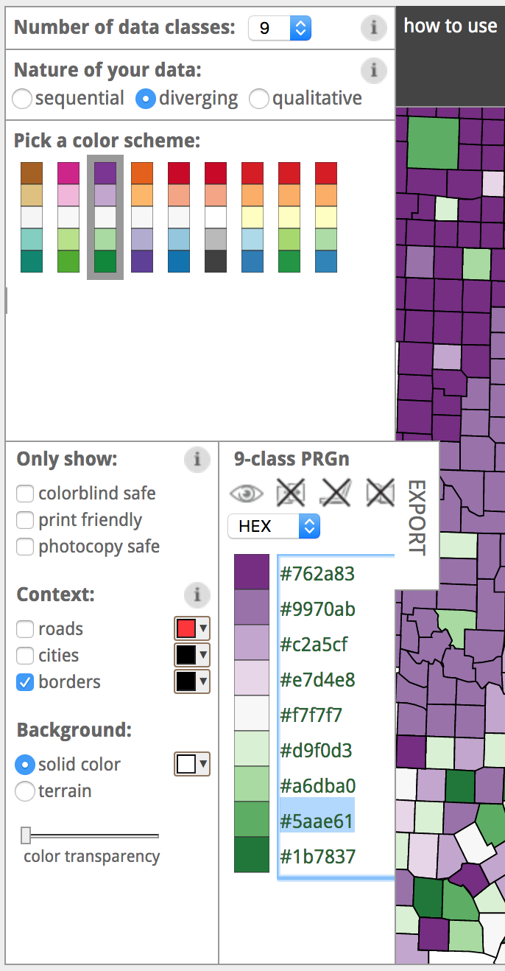
https://colorbrewer2.org/

Slide 20
https://colorbrewer2.org/

Slide 21
References
Datasets were taken from the Women, Minorities, and Persons with Disabilities in Science and Engineering Report https://ncses.nsf.gov/pubs/nsf19304/data
Some of the slides (*) were taken from a previous R Bootcamp Workshop I did with Rogan Magee in 2017

Slide 22
Thank you!!!
Tess Cherlin
tess.cherlin@jefferson.edu
@alldayscientess

